Slide 1
Title, Project ID, Names and Supervisor
Title | Activity Management System
Project ID | 1B14048
Names | Elden Chung
 | Lee Jun Quan
Supervisor (s) | Low Poh Lian

Slide 2
Description/Objectives of project
This is a continuation project. To convert the existing stellar system to support Chinese using resource localization for server and client side. To apply localization for client and server side to support templates for use in preschools. To Modify and create new templates.
WPF Client and MVC 4 Server
Software:
A) Visual Studio 2010/2012
B) SQL Server Management Studio R2

Slide 3


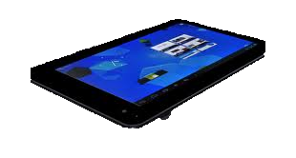
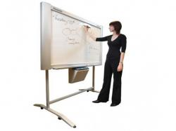
Architecture Overview
Teacher site
Wireless/ LAN
Server site
Student site

Slide 4
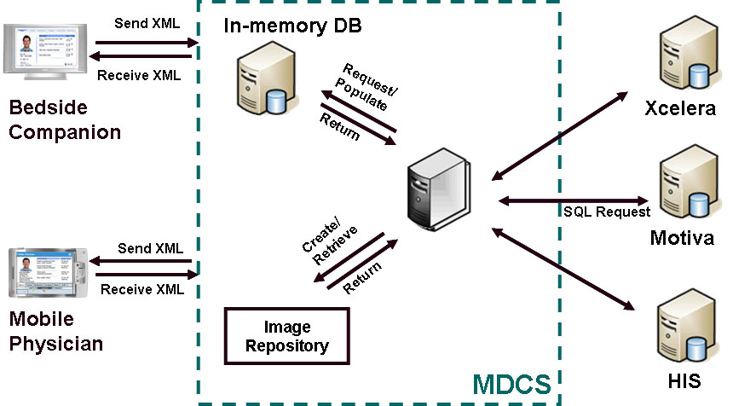
Design Architecture – Sample 1

Slide 5
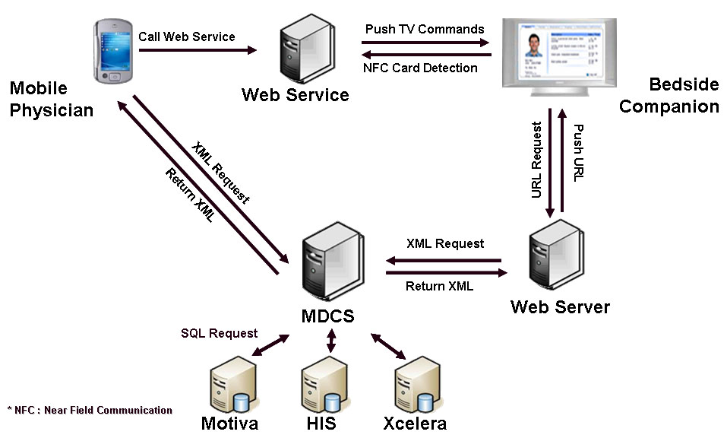
Design Architecture – Sample 2

Slide 6
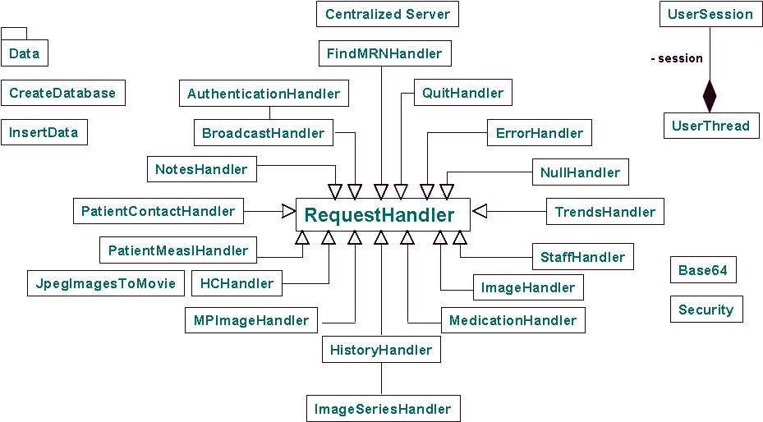
Detailed Design – Class Diagram Sample 1

Slide 7
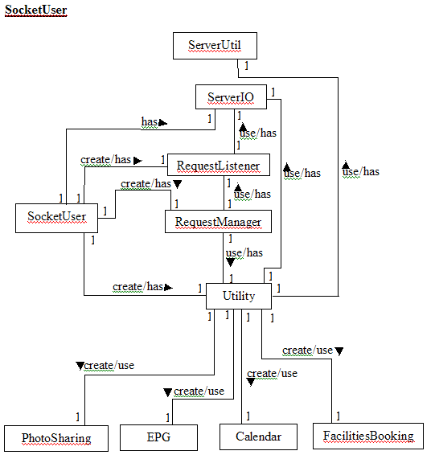
Detailed Design – Sample 2

Slide 8
Job Distribution (a concise breakdown of tasks)
Category | Work | JunQuan | Elden
Server-Side | Modules to interface to PC client | ✓
 | Modules to interface to mobile client | ✓
 | Modules to control home appliances | ✓
PC client | Modules to connect to server |  | ✓
 | Modules to list all home appliances and its status |  | ✓
 | Modules to interact with server control home appliances |  | ✓
Database Design |  | ✓ | ✓
Integration |  | ✓ | ✓
Testing |  | ✓ | ✓

Slide 9
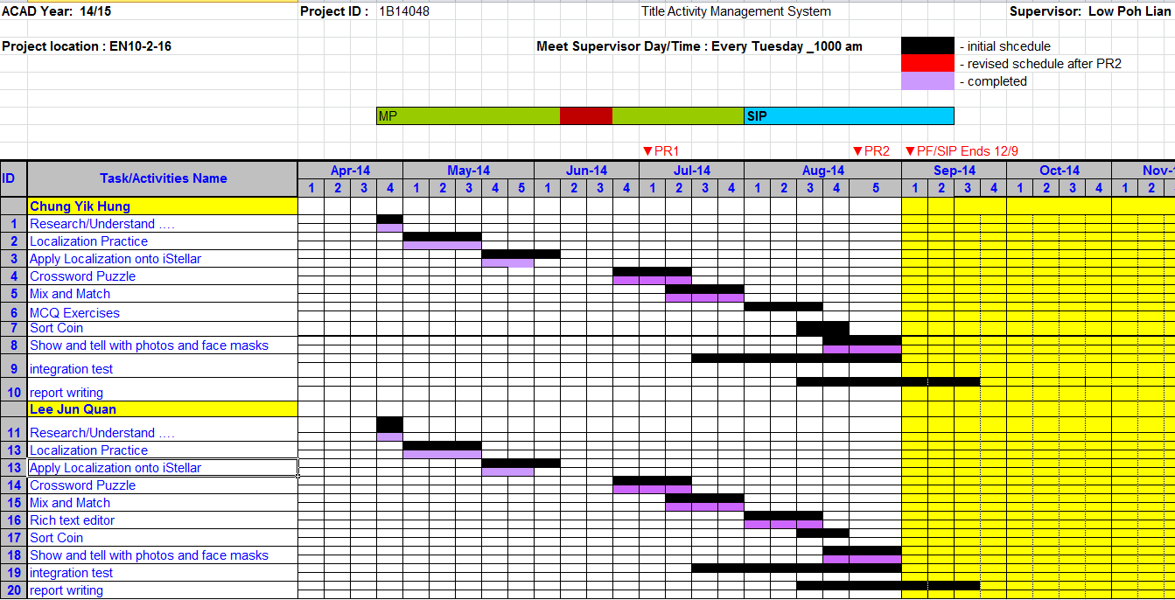
Milestones and % completed

Slide 10
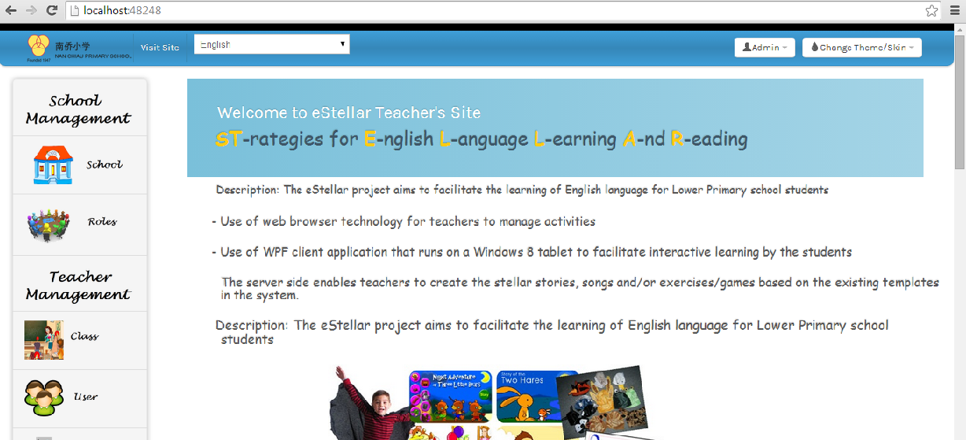
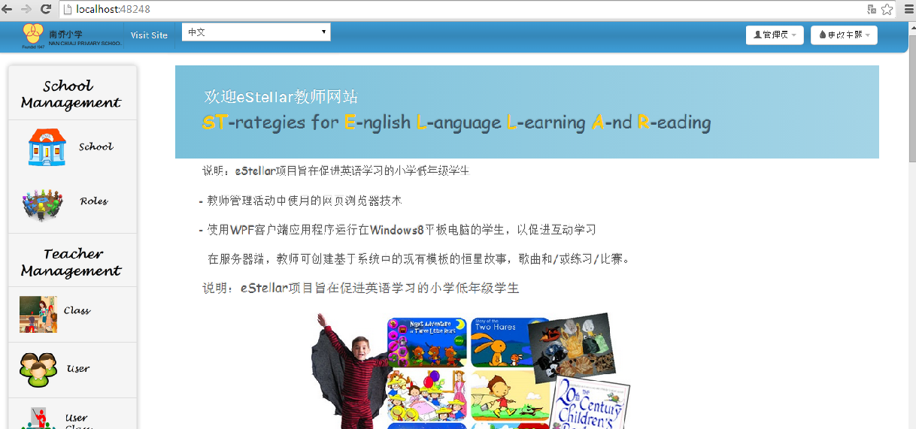
Screenshots
Teacher Website (English and Chinese)

Slide 11
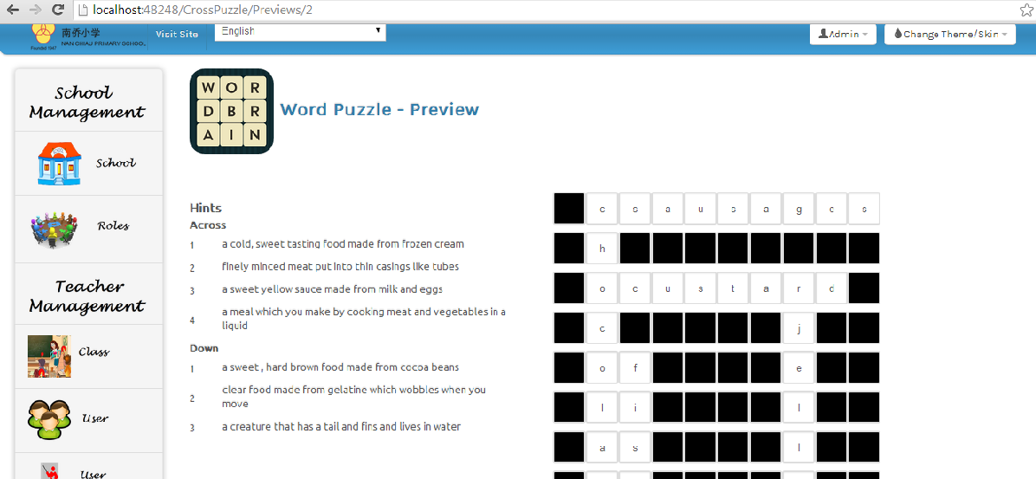
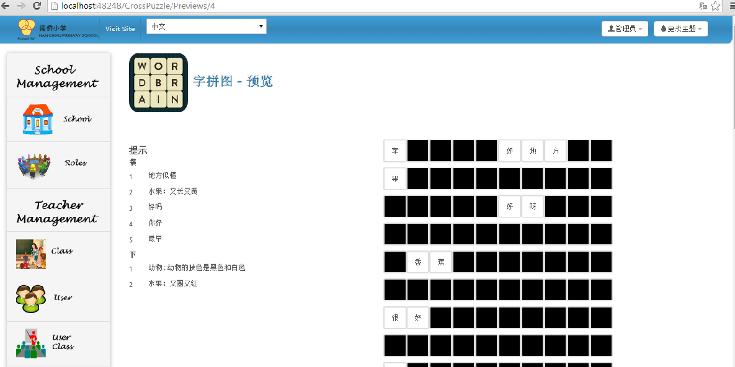
Screenshots
Teacher Website (English and Chinese Crossword Puzzle)

Slide 12
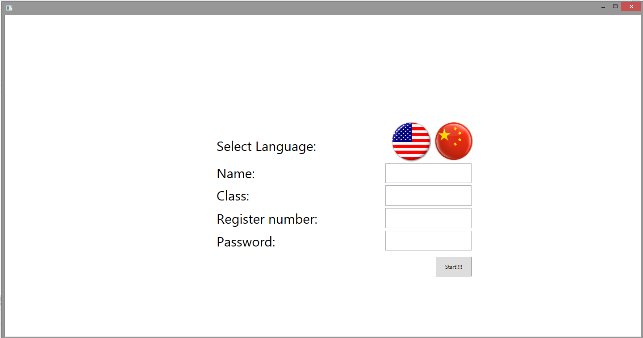
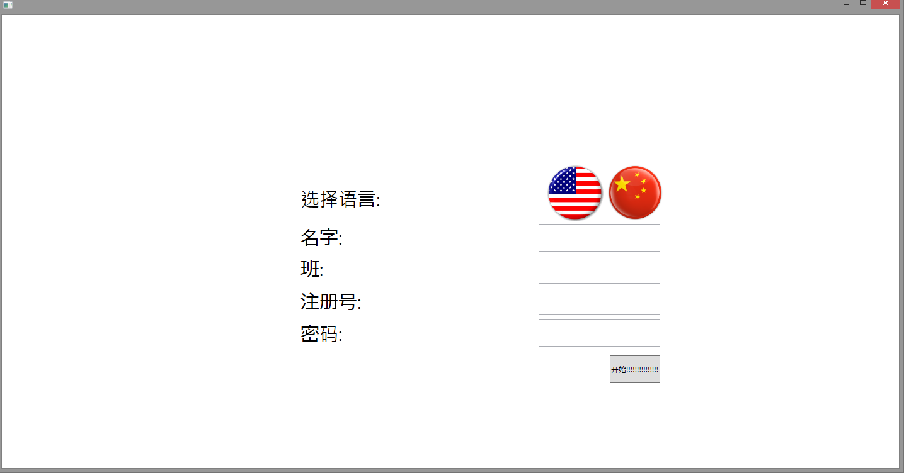
Screenshots
Student Client site (English and Chinese)

Slide 13
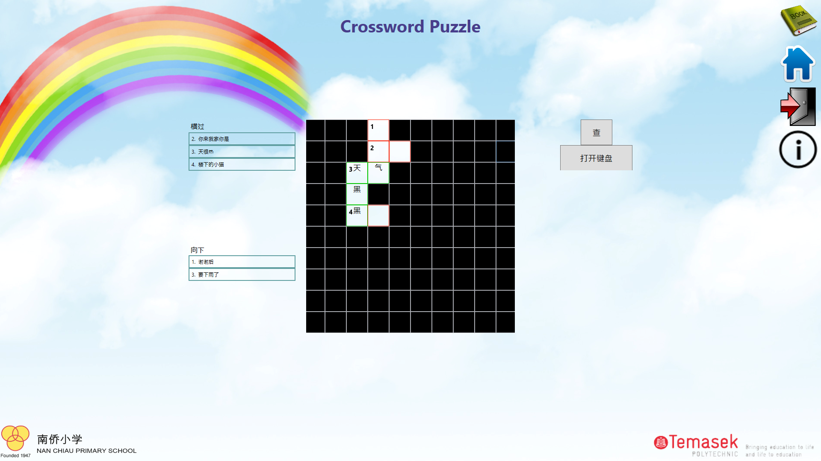
Screenshots
Student Client site (Chinese Crossword Puzzle)

